Slide 1
Survey of Cloud Computing and Azure Foundation
Module 1, Lesson 1:
Cloud Computing Overview

Slide 2
Topics
What is Cloud Computing?
Cloud Service Models
Cloud Deployment Models
Why Cloud Computing?
Cloud Vendors

Slide 3
Objectives
By the end of this lesson you should be able to:
Define cloud computing and review types of service offered and deployment models available
Explain cloud computing evolution and development of enabling technologies
Understand how cloud computing is utilized and why it is gaining popularity and momentum
Compare and summarize the major cloud computing vendors

Slide 4
What is Cloud Computing?
“The practice of using a network of remote servers hosted on the Internet to store, manage, and process data, rather than a local server or a personal computer.”
Oxford Dictionary
Notes:
Notes:
Start off with a non-technical definition from Oxford Dictionary.

Slide 5
What is Cloud Computing?
“The practice of storing regularly used computer data on multiple servers that can be accessed through the Internet.”
Webster Dictionary
Notes:
Notes:
Start off with a non-technical definition from Webster dictionary.

Slide 6
What do you think Cloud Computing is?
Cloud Computing
Notes:
Notes:
The purpose of this slide is to open discussion with the students in order to ascertain their perceptions of cloud computing.
The instructor should lead the students in exploring various perspectives of cloud computing.
Suggested ‘buzz words’ to get conversation started:
Network
Data
Services
Shared
Internet
Resources
Software
Model
Costs

Slide 7
Cloud Computing Perspectives
Perspectives highly influenced by roles and responsibilities within an organization
End-User
Application Developer
IT Infrastructure Manager
CIO
CFO
Service Provider
Notes:
Notes:
This slide serves as a follow-up to the discussion generated by the previous slide.
Similar to six blind individuals trying to describe an elephant from just the parts they come in contact with, people’s perspective on cloud computing will be influenced by their roles and responsibilities within an organization.
What cloud computing means to people in different roles:
end-user:
services available on various platforms anytime, anywhere, as long as an Internet connection is available
application developer
a development platform that can be dynamically configured and easily tested
service provider or infrastructure manager
the ability to dynamically setup hardware and implement services, t
increasing available resources during peak times
releasing resources during slower periods.
CFO
economic model for consuming technology in a pay-as-you-go format
Allows company to spend limited resources on only what they need and use, expanding as necessary
CIO
virtualization model for technology from infrastructure to delivery

Slide 8
What is Cloud Computing? – Take 2
Further perspectives include:
“An approach to computing that’s about Internet scale and connecting to a variety of devices and endpoints.”
“Treating hardware and software resources as a utility.”
“A way to save a ton of money by only paying for what you need.”
“A way to scale huge when you need something done fast.”
Notes:
Notes:
These additional definitions provide further perspectives on cloud computing.
There isn’t any specific origin to each of these quotes.
they are an amalgamation of sentiments and perspectives expressed by various people and entities on the Internet

Slide 9
Cloud Computing NIST Definition
Cloud computing is a model for enabling ubiquitous, convenient, on-demand network access to a shared pool of configurable computing resources (e.g., networks, servers, storage, applications, and services) that can be rapidly provisioned and released with minimal management effort or service provider interaction. This cloud model is composed of five essential characteristics, three service models, and four deployment models.
National Institute of Standards and Technology
Notes:
Notes:
In previous slides, we have reviewed various definitions of cloud computing. We conclude this exploration of perspective with the presentation of the NIST (National Institute of Standards and Technology) definition which is quite comprehensive
leads to the discussion of:
five characteristics
three service models
four deployment models
References:
http://www.nist.gov/itl/cloud/

Slide 10
Evolution of Cloud Computing
Stage | Characteristics
Grid Computing | Solving large problems with parallel computing Made mainstream by Global Alliance
Utility Computing | Computing resources offered as a metered service Late 1990s
Software as a Service | Subscription-based software accessed over the Internet Gained momentum after 2001
Cloud Computing | Next-generation datacenters with virtualization technology Full stack of service - IasS, PaaS, & SaaS
Order of Evolution
Notes:
Notes:
Over the past twenty years or so, typical business application architecture has evolved from desktop-centric to client-server solutions, and then to loosely coupled web services and service-oriented architecture. These steps have led to the migration of applications and services from being centrally hosted either on the desktop or enterprise servers to Internet-hosted distributed systems.
Grid computing was used primarily to solve large problems by collecting computers from multiple locations and processing in parallel to solve a common goal. Utility computing followed the charging practice of utility companies and provided computing resources on the basis of metered usage. The important concept here is that service vendors began incorporating the ability to monitor the use of resources on a fine grain level. This allowed them to charge for resources like a metered utility. This ability eventually becomes one of the defining characteristics of cloud computing where clients are only charged for resources that they use, when they use it. As the Internet became ubiquitous, software services started moving over to the Web. Applications such as email and CRM (customer relationship management) applications led the way.
The purpose of this slide is to show some key steps that has lead to the current state of cloud computing. Subsequent slides will cover technology, characteristics, service models (IaaS, PaaS, SaaS), deployment models, etc. and will more fully explain components which lead to the current state of cloud computing. The slide shows bullets under cloud computing for the sake of completeness. The instructor should not spend too much time attempting to explain the concepts under cloud computing since they will be covered fully in later slides.
IaSS=Infrastructure as a Service
PaaS=Platform as a Service
SaaS=Software as a Service

Slide 11
Key Enabling Technologies
Ubiquitous fast wide-area networks
Powerful and inexpensive servers
High-performance virtualization technology
Widespread Broadband
Hadoop
Linux Web Hosting
Microsoft SQL Server
Windows
Windows Server
Virtualization
Notes:
Notes:
Ubiquitous availability of fast wide-area networks
Widespread adoption of broadband access
Powerful and inexpensive server computers
Hardware cost has reduced exponentially over the past few decades
Multi-Core / Multi-thread
High-performance virtualization technology
Separates hardware from the operating system through the use of an abstraction layer (hypervisor)
Virtualization gives users the illusion of full access to a system of resources which may actually be shared by multiple users

Slide 12
Five Key Cloud Characteristics
On-demand self-service
Ubiquitous network access
Location-independent resource pooling
Rapid elasticity
Pay for what you use
Notes:
Notes:
On demand self-service:
This characteristic provides users with full control over their provisioned resources.
They should be able to power-up, increase, decrease, shutdown, or modify any other characteristics of their utilized resources without requiring assistance from the service provider.
Ubiquitous network access:
This characteristic refers to the widespread availability of broadband access to the Internet.
Further, the cloud should be accessible by various devices such as mobile phones, tablets, laptops, and workstations.
Location-independent resource pooling:
Cloud computing clients come from all over the world.
Service providers should be able to serve each of these clients equally well.
The quality of services or resources consumed by the client should not be dependent on the location of the client.
Service providers should be able to dynamically pool resources that may be geographically separated to create the illusion of a single unified service to the client.
Rapid elasticity:
The cloud service provider should be flexible in the provision of resources to meet the fluctuating demands of their customers.
Pay per use:
Expanding on the concept of utility computing, customers of cloud computing service providers are charged only for the resources they use.

Slide 13
Cloud Computing Service Models
Model | Description
Software as a Service (SaaS) | Consume it End-User Applications delivered as a service, rather than by on-premises software
Platform as a Service (PaaS) | Build on it Application platform or middleware provided as a service on which developers can build and deploy custom applications
Infrastructure as a Service (IaaS) | Migrate to it Computing, storage, or other IT infrastructure provided as a service, rather than as a dedicated capability
Notes:
Notes:
Cloud computing is delivered via three models.
IaaS (migrate to it)
PaaS (build on it)
SaaS (consume it)
Some sample companies that offer one or more of these service models are listed below. While some companies’ services are clearly specific to a particular model (MS Office 365, for example), some crossover multiple boundaries. Microsoft Azure is primarily a PaaS service model; however, its virtual machines (VMs) are IaaS services. Amazon Web Services (AWS) is primarily an IaaS service with its EC2 and S3 offerings; however, AWS has begun offering Elastic Map Reduce (EMR) with the necessary components for big data scientists and developers to develop map-reduce and Spark programs. (These concepts will be discussed in detail in later lessons.)
Sample Service Providers and Services:
Amazon
Web Services
EC2
Google
Gmail
App Engine
Cloud Storage
Microsoft
Office 365
Exchange Online
SharePoint Online
Windows Live Hotmail
Windows Azure
Salesƒorce
ƒorce.com
rackspace

Slide 14
Service Model Division of Responsibility
Infrastructure
(as a Service)
Platform
(as a Service)
Software
(as a Service)
On-Premises
Applications
Applications
User Managed
Applications
Applications
User Managed
Data
Data
Data
Data
Runtime
Runtime
Runtime
Runtime
Managed by Provider
User Managed
Middleware
Middleware
Middleware
Middleware
Managed by Provider
Operating System
Operating System
Operating System
Operating System
Managed by Provider
Virtualization
Virtualization
Virtualization
Virtualization
Servers
Servers
Servers
Servers
Storage
Storage
Storage
Storage
Networking
Networking
Networking
Networking
Notes:
Notes:
In a traditional on-premises environment, the company’s IT department manages all of the layers of the computing environment. This slides shows where the division of management of the computing layers occur in each of the cloud service models discussed.

Slide 15
Software as a Service (SaaS)
Internet hosted software
Full vendor maintenance
No upfront cost
Pay for services as they are consumed
Applications
Data
Runtime
Managed by Provider
Middleware
Operating System
Virtualization
Servers
Storage
Networking
Notes:
Notes:
Examples: MS Office 365, Gmail, Hotmail, SalesForce, Google Drive
In this model, software is hosted as a commodity that can be accessed by the user on the Internet.
Customers do not need to worry about updates and underlying infrastructure needs.
Service vendors are responsible for maintenance; however, in most cases, clients do not have the freedom to customize other than through the configuration of options.
Customers can reduce their upfront costs and instead pay for the resources they consume.
(It should be noted that Gmail and Hotmail both have free service versions as well as enterprise versions to help companies manage their email.)

Slide 16
Platform as a Service (PaaS)
Delivers and manages various development environments
Environment and tools can be easily provisioned and torn down
User Managed
Applications
Data
Runtime
Middleware
Managed by Provider
Operating System
Virtualization
Servers
Storage
Networking
Notes:
Notes:
Examples: Microsoft Azure, Google Apps, force.com
This service delivers and manages various development environments for application developers, software developers, web developers and data scientist allowing them to concentrate on their core tasks rather than on hardware/software and infrastructure maintenance
Tools for each of the design, development, testing and deployment phases can be easily provisioned and torn down

Slide 17
Infrastructure as a Service (IaaS)
Dedicated virtual machines (VMs)
Users configure server type, operating system, storage, network, etc.
Scale up and down
Applications
User Managed
Data
Runtime
Middleware
Operating System
Managed by Provider
Virtualization
Servers
Storage
Networking
Notes:
Notes:
Examples: Amazon Elastic Compute Cloud (EC2), Amazon Simple Storage Service (S3), Rackspace, Microsoft Azure VM
This model provides dedicated virtual machines to clients,
Allows client full control over the parameters of the machine instance.
Users can provision and configure the following through a web-based console:
server types
CPU cycles
operating systems
storage capacity
network infrastructure
security setting
Users can easily provision and tear down these virtual machines to suit their current needs.

Slide 18
Cloud Deployment Model
Hybrid Cloud
Bridge
Private Cloud
Public Cloud
Community Cloud
Notes:
Notes:
Private Cloud (also known as internal cloud):
This deployment model of cloud computing is implemented on a cloud-based secure environment and access is restricted to authorized users only.
Utilizing this model provides organizations the opportunity to control their data and establish their own security measures.
Public Cloud:
Cloud services are delivered over a network (Internet) and are open for public usage.
Community Cloud:
This deployment method represents a cloud computing model somewhere between public and private.
Setup is mutually shared between organizations with shared interest (such as banks or trading firms) and access is restricted to these organizations.
Private Access
Hybrid:
A combination of all of the above, comprising multiple servers dedicated to either private or public access.

Slide 19
Cloud Deployment Models – Advantages & Characteristics
Model | Advantages and Characteristics
Public | Shifts capital expense to operating expense Offers pay-as-you-go pricing Supports multiple tenants
Private | Leverages existing capital expense Can help reduce operating costs Intended for a single tenant
Hybrid | Bridges one or more community, private, or public clouds Allows manipulation of CapEx and OpEx to optimize cost Supports resource portability
Community | Allows sharing of CapEx and OpEx to reduce costs Brings together groups with a common interest Supports resource portability

Slide 20
Why Cloud Computing?
Pas As
You Go
Lower TCO
24x7 Support
Reliability, Scalability
Why Cloud Computing?
Device- & Location-Independent
Lower Capital Expenditure
Easy & Agile Deployment
Free Up Internal Resources
Utility Based
Highly Automated
Notes:
Notes:
Cloud computing is becoming very popular because they are flexible, reliable and cost effective. Items in this slide are categorized into one of these characteristics below:
Flexibility
Scale up and down to meet organization requirements and pay as you go
Charge for services on a fine grain level such as usage hours, Gbytes used, etc.
Easy and agile to deploy
Highly automated
Device- and location-independent
Reliability
24x7 support
Vendor responsible for hardware maintenance
Vendor responsible for software updates and maintenance for SaaS model
Cost
Reduce total cost of ownership (TCO)
Free up internal resources
Lower capital expenditure

Slide 21
Typical Computing Pattern
On and Off
On & off workloads
Batch jobs
Wasted Capacity
Time to market can be cumbersome
Inactivity
Period
Compute
Time
Notes:
Notes:
This slide and the next three show typical computing patterns of enterprise organizations. In-house resources are often detrimentally affected by these patterns of usage. These computing patterns illustrate the advantages of organizations moving to cloud computing services to meet their IT resource requirements.
On and off workloads (e.g., batch jobs):Over-provisioned capacity is wasted. Time to market can be cumbersome.

Slide 22
Typical Computing Pattern
Rapid Growth
Rapidly growing company
Major challenge for IT dept. to keep up with growth
Potential loss of business opportunity
Potential customer service problems
Compute
Time
Notes:
Notes:
Rapid growth:
Successful services need to grow/scale, but keeping up with growth is a major challenge for organization’s IT departments.
Often, hardware cannot be provisioned fast enough and software cannot be patched and updated as necessary.
this can lead to potential loss of business opportunities as well as customer dissatisfaction

Slide 23
Typical Computing Pattern
Unexpected peak in demand
Loss of business opportunity
Wasted capacity if demand wanes
Unpredictable Bursting
Compute
Time
Notes:
Notes:
Unpredictable bursting:
Unexpected/unplanned peaks in demand can cause sudden spikes, which impact performance.
Perhaps there is a sudden demand for a particular item. Using in-house resources, IT is unable to over-provision for extreme cases.

Slide 24
Typical Computing Pattern
Seasonal peaks and troughs
Provisioning dilemma
Wasted capacity or
Loss of business
Predictable Bursting
Compute
Time
Notes:
Notes:
Predictable bursting: Services may have micro-seasonality trends, experiencing peaks due to periodically increased demand.
This adds to IT complexity and results in wasted capacity.
This pattern is very challenging for management and the IT department since both hardware/software resources as well as human resources to manage these additional resources are necessary.

Slide 25
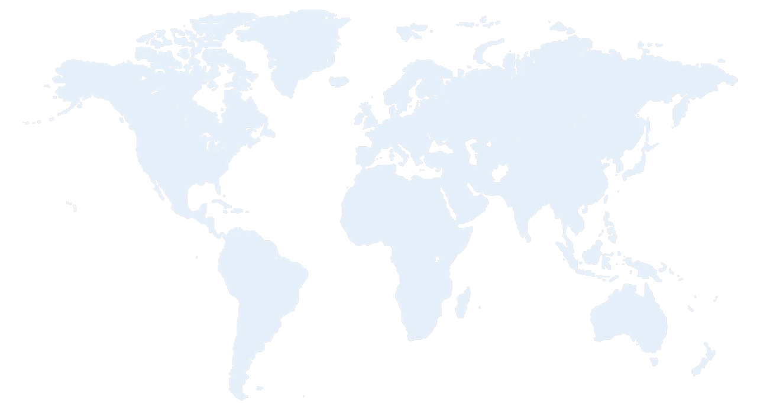


Azure Datacenter Regions
North America
Europe
Asia Pacific
N. Europe
Central US
N. Central US
W. Europe
Japan West
West US
China North
Japan East
East US
East US 2
Central India
China South
S Central US
E. Asia
S.E. Asia
West India
Brazil South
South India
Australia East
Australia Southeast
Notes:
Notes:
Another important factor of cloud computing is that it is location independent.
This slide and the next show datacenter regions serving users on various continents for Azure and AWS.

Slide 26
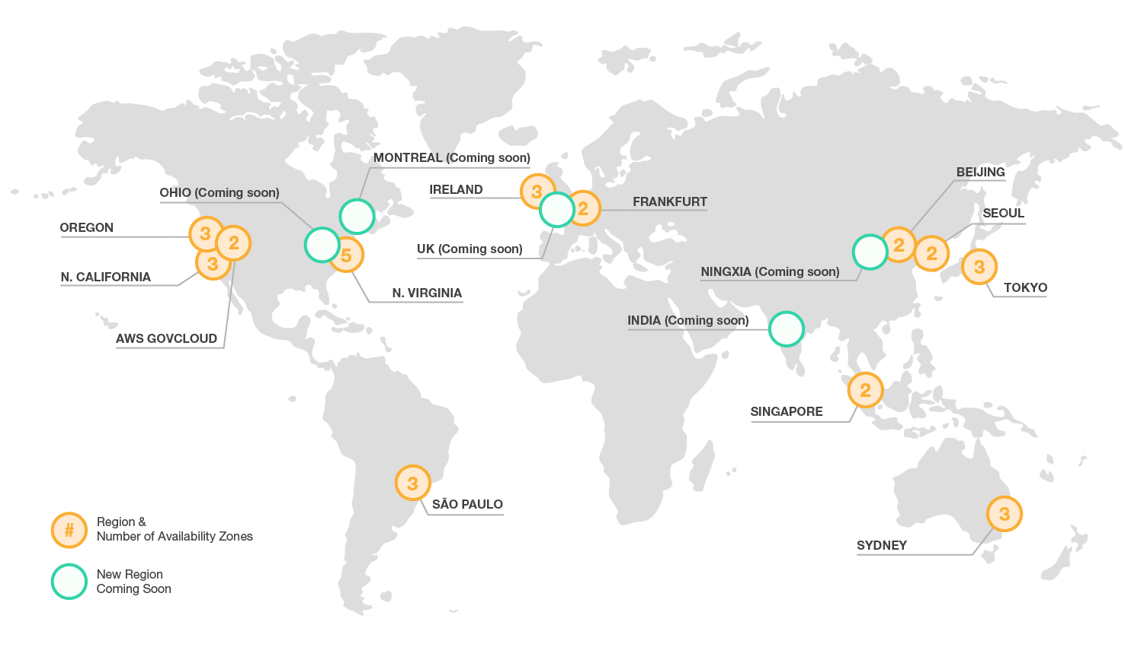
Amazon AWS Datacenter Regions

Slide 27
Cloud Computing Examples
A large enterprise quickly & economically deploys new internal applications to its distributed workforce.
An e-commerce website accommodates sudden demand for a “hot” product caused by a viral buzz.
A pharmaceutical research firm executes large-scale simulations using computing power provided by cloud vendors.
A media company serves unlimited video, music, and other media to their worldwide customer base.
Notes:
Notes:
These are all different scenarios in which cloud computing becomes necessary for efficiency.
Walmart’s OneOps is a great example of this exact principle. MS Azure allows for the same flexibility.
The second example (viral buzz) provides a great example of why paying only for what you use is useful
Cloud computing has a built in scalability that is impossible to replicate in your own servers,
you cannot change your hardware rapidly enough to accommodate something like viral buzz
Cloud computing allows you to scale up and down as needed
It is very useful to run simulations using cloud computing, you can have dozens of cores simultaneously running your simulations making the process incredibly fast
Cloud computing’s scalability really allows global applications
There must be a server within the vicinity that allows the service to host and stream their content to the user. Without this, the company would loose customers for disappointing streaming speeds and unreliability.

Slide 28
Cloud Computing Nutshell
End-users connect over the Internet to the cloud from their own personal computers or portable devices in order to access services.
To the end-user, the underlying infrastructure such as the hardware, operating system, etc., is invisible
Servers
Laptops
Desktop
Application
Platform
Infrastructure
Phones
Tablets
Cloud Computing
Notes:
Notes:
This slide summarizes many of the subjects we have discussed so far.
Reiterates the three service models and the services provided by each, as well as the different ways the cloud can be accessed.
Cloud Computing: (Events in / properties of)
Application:
Monitoring
Content
Collaboration
Communication
Finance
Platform:
Object Storage
Identity
Runtime
Queue
Database
Infrastructure
Compute
Block Storage
Network

Slide 29
Cloud Vendor - Azure & AWS
Microsoft Azure and Amazon Web Services (AWS) offer broad and deep capabilities with global coverage
Category | Azure Service | AWS Service
Computing infrastructure | Virtual Machines | EC2
Object storage infrastructure | Blob Storage | S3
Networking | Virtual Network | Virtual Private Cloud
Relational database-as-a-service | SQL Database | RDS
NoSQL document database | DocumentDB | DynamoDB
Big data processing | HDInsight | Elastic MapReduce (EMR)
Visualization | Power BI | QuickSight
Notes:
Notes:
This slide and the next represent an overview of the services offered by the four major vendors in cloud computing in each of the categories listed.
Instructors should not spend too much time in explaining the specifics of services provided by each of the vendors, but rather discuss what types of services are available or unavailable in each category.
Computing infrastructure:
provides persistent, durable storage volumes for use with virtual machines and offers the option to select different underlying physical storage types and performance characteristics.
Object storage infrastructure:
is employed for use cases including cloud applications, content distribution, backup, archiving, disaster recovery, and big data analytics.
Relational database-as-a-service (DBaaS):
a model where the database resilience, scale, and maintenance are primarily handled by the platform.
A NoSQL document database:
a service that automatically indexes JSON data for applications that require rich query and multi-document transactions.
Big Data processing:
is used for very large, multi-type (structured data, unstructured data, multimedia, log data, social network data, etc) data that is accumulating at a very quick pace. (3V of Big Data = Volume, Variety, Velocity)
Visualization:
refers to business intelligence and other visualization tools to perform ad-hoc or in-depth analysis, develop business insights from data, and display results in a visually intuitive manner (typically for decision makers).
References:
https://azure.microsoft.com/en-us/
https://aws.amazon.com/products/?nc2=h_ql_ny_livestream_blu

Slide 30
Cloud Vendor - Bluemix & Google
IBM Bluemix and Google Cloud each offer and deploy applications on highly-scalable and reliable infrastructure
Category | Bluemix | Google Service
Computing infrastructure | Virtual Server, Containers | Compute Engine
Object storage infrastructure | Object, Block Storage | Cloud Storage
Networking | Virtual Private Network | Cloud Virtual Network
Relational database-as-a-service | SQL Database | Cloud SQL
NoSQL document database | MongoDB | Cloud Datastore, Bigtable
Big data processing | Analytics for Apache Hadoop | BigQuery, Cloud Dataproc
Visualization
Notes:
Notes:
Bluemix:
IBM's Cloud Platform as a Service and more
It lets you quickly create, deploy, and manage your applications in the cloud. You don't have to deal with any of the underlying infrastructure.
Virtual Server
designed to support both cloud-native and cloud-enabled workloads, helping companies move faster and scale better across apps and services of all types.
Object Storage
built on OpenStack Swift and provides redundant, scalable object storage clusters for storing, managing, and retrieving virtual server images, media content, or financial data.
Google Cloud Platform:
a set of modular cloud-based services that allow you to create anything from simple websites to complex applications.
Google Compute Engine
delivers virtual machines running in Google's innovative data centers and worldwide fiber network.
tooling and workflow support enable scaling from single instances to global, load-balanced cloud computing.
Cloud Datastore
highly-scalable NoSQL database for your applications.
automatically handles sharing and replication.
Bigtable
designed to handle massive workloads at consistent low latency and high throughput, so it's a great choice for both operational and analytical applications, including IoT, user analytics, and financial data analysis.
BigQuery
Google's fully managed, petabyte scale, low cost analytics data warehouse.
NoOps, there is no infrastructure to manage and you don't need a database administrator, so you can focus on analyzing data to find meaningful insights, uses familiar SQL.
References:
https://cloud.google.com/
https://console.ng.bluemix.net/

Slide 31
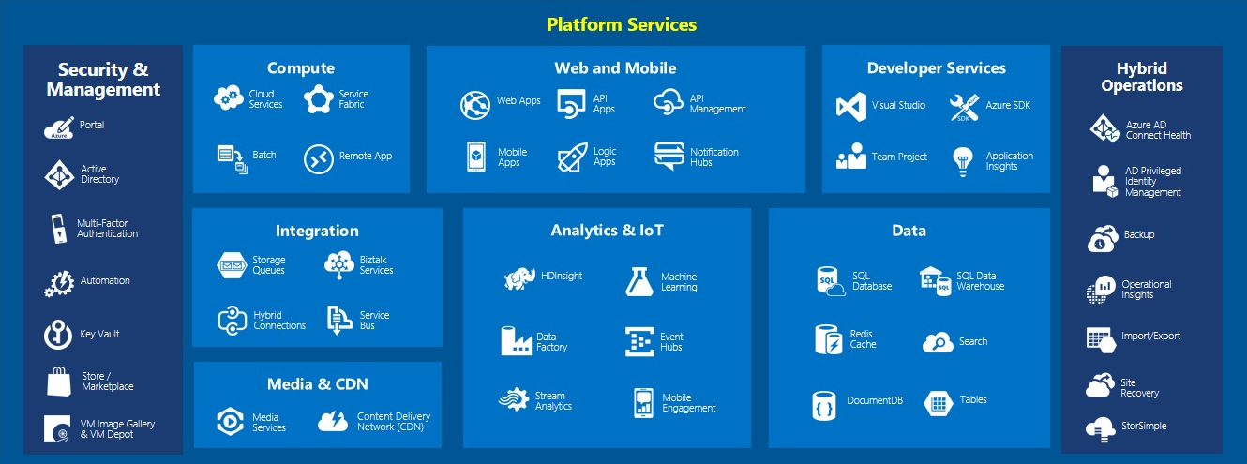
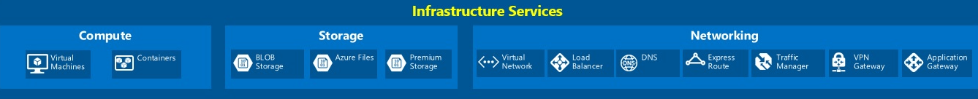
Azure Services
Notes:
Notes:
Instructors should not attempt to explain each and every service type shown on the slide. Azure services will be more fully explored in Module 1 lessons 3 and 4. This slide is a demonstration to students that the Azure services can be broken up into various categories (i.e., PaaS, IaaS, and administrative) and subcategories (i.e., Compute, Web and Mobile, Developer, etc.)
Azure is a comprehensive platform, with a smorgasbord of elements and services.
The core infrastructure services are shown at the bottom of the slide.
The middle layer offers services that are more oriented towards enterprise or private development with services to gather, massage and display data for example.
The Web and Mobile and Developer Services shown at the top are oriented more for the development of end-user software and services that can be developed, tested, and deployed under the Azure platform.
References:
Image Source: https://blogs.msdn.microsoft.com/niallsblog/2015/05/18/running-a-high-volume-website-on-azure-infrastructure-services/

Slide 32
Azure Usage
Azure Active Directory Users
More than 500 Million
Storage transactions per day
More than 777 Trillion
Messages processed by Azure IoT per month
More than 1.5 Trillion
Active Websites
More than 250,000
Percentage of Fortune 500 Companies using Azure
More than 80%
Authentications per week
More than 13 Billion
SQL Databases in Azure
More than 1.5 Million
Developers registered with Visual Studio Online
More than 1 million
Notes:
As of 2015

Slide 33
Vendor Lock-In
Companies that adopt cloud computing must be wary of potential vendor lock-in issues
Company’s entire data is stored with a single vendor’s cloud storage
Company relies on a single vendor for all of its computations
Changing vendors can be very costly

Slide 34
Summary
In this lesson, you have learned:
Cloud Computing
Ubiquitous via network access
Location-independent shared pool of computing resources
On-demand rapid provisioning and tear down
Pay only for current client requirements
Service Models
IaaS, PaaS, SaaS
Deployment Models
Public, Private, Community, and Hybrid
Notes:
Notes:
The Module 1 Lesson 1 Lab should be completed at this time:
https://github.com/MSFTImagine/computerscience/tree/master/Complimentary%20Course%20Content/Module1/Labs
We have learned that Cloud Computing allows ubiquitous, location free, on-demand network access to a shared pool of computing resources that users can rapidly provision and tear down to meet their current needs and only pay for services that they use.
Users are offered infrastructure as a service, platform as a service, or software as a service. These services are distinguished by who is responsible for the support of the underlying software, hardware and infrastructure and how it is managed. Services can be deployed in either public, private, community, or hybrid clouds.

